Slide 1

No-Code and Low-Code Agentic AI
Use Cases, Benefits, Limitations, and Visual Agent Design

Slide 2
What Is an AI Agent?
Moving from a smart advisor to an active assistant that can act on its own.

Slide 3
The Four Pillars of an Agent
Planning: It breaks a big goal into smaller steps and figures out the right order to do them.
Tool use: It can actually do things: open websites, edit files, call apps, run code.
Autonomy: It keeps working through a task without you having to approve every step.
Self-correction: If something doesn't work, it notices and tries a different approach.

Slide 4
Why This Matters Now
AI agents have existed as a concept for a while, but 2024 and 2025 are when they became easy for regular people to use.
Capable Models
The underlying AI models have finally achieved the intelligence and reliability required to execute complex tasks.
Intuitive Tools
User interfaces and software integrations have become incredibly simple, lowering the barrier to entry.
Zero Code
You no longer need to write complex code or understand backend APIs to put AI agents to work for you.

Slide 5
Tools at a Glance
Platform | Skill Level | Best For
ChatGPT Agent Mode | Beginner | Quick web research, compiling info.
Manus | Beginner | Polished research reports, reusable workflows.
Claude Cowork | Low to Medium | Organizing local files and cloud apps.
OpenClaw | High | 24/7 personal assistant, learns preferences.
Zapier | Low | Connecting business apps, event triggers.
n8n | Medium to High | Complex pipelines, high control.
Claude Code | Medium to High | Building real software, testing code.

Slide 6




Beginner-Friendly Agents
ChatGPT Agent Mode
Manus
The easiest starting point. Gives ChatGPT a real browser to visit websites, read content, and pull info together.
Handles big tasks start to finish. Builds interactive dashboards. Skill Creator lets you save workflows.

Slide 7

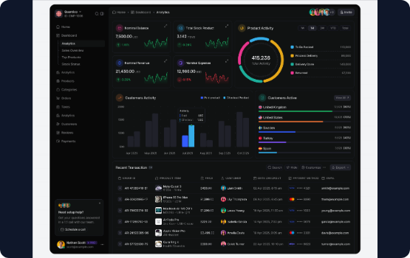
Deep Dive: Manus Use Cases
•
Deep research reports: Point it at a topic, it searches everywhere and builds a full interactive dashboard.
•
Content gap analysis: Find the questions no one in your niche is answering.
•
Infographic QA: Upload an AI-generated image, get it back with errors fixed.
•
YouTube descriptions: Give it a video link, it watches and writes the description with timestamps.

Slide 8


Desktop and Personal Assistants
Claude Cowork
OpenClaw
An assistant with access to your computer. Can read, rename, organize, create, and move files on your behalf. Great for sorting large numbers of files.
An open-source personal AI assistant that runs 24/7. Connects to email, calendar, browser. Learns your preferences over time. Requires server setup.

Slide 9




Workflow Automation
Zapier
n8n
Connects over 7,000 apps. Use plain English to set up automations. Great for simple event triggers across multiple tools.
Full control over APIs, logic, and data flow. Build visually by connecting blocks. Free to run on your own server.

Slide 10
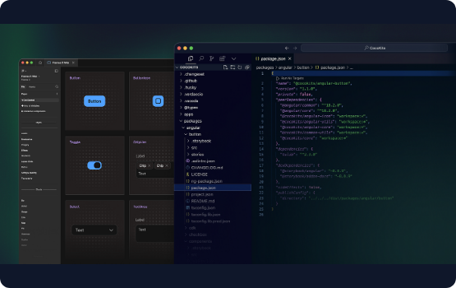
Coding Agents: Claude Code
Unlike other tools, Claude Code actually builds software. You describe what you want, and it writes, tests, and fixes the code.
•
Clone apps: Analyze screenshots to build a working version.
•
Chrome extensions: Automate browser tasks easily.
•
Internal tools: Build project trackers or dashboards without waiting for a developer.

Slide 11
Getting the Most Out of Agents
Improve your prompt: Ask AI to rewrite your prompt for the specific tool you're using.
Be specific: Describe what a good result looks like and who it's for.
Start simple: Get one thing working before adding complexity.
Check outputs: Agents can make mistakes confidently. Always review.
Work in a copy: Never let an agent work on your only version of a file.

Slide 12
Live Demo: n8n Visual Design
Building local, free, zero-API-cost workflows.

Slide 13
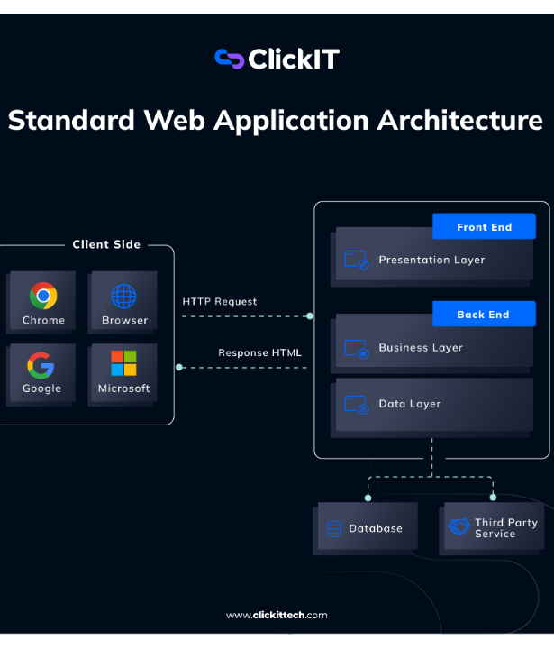
n8n: The Local Advantage
n8n is ideal for full-control workflows. By running it locally, you can leverage completely free resources without API limits.
In this demo, we will use open-source local LLMs (like Llama 3 via Ollama) and basic webhooks—no paid subscriptions required.

Slide 14


Use Case 1: Content Repurposing Agent
The Goal
The Setup (No-Cost)
Take a long-form text (e.g., a video transcript) and automatically generate a blog post, a Twitter thread, and a LinkedIn post.
Input via Webhook/Local File. Connect to an Ollama Node running Llama 3 locally. Output to a local markdown file or email.

Slide 15
Content Agent: Step-by-Step in n8n
Trigger: Use a Webhook Node to receive the raw text payload.
AI Node 1 (Blog): Prompt local LLM: "Turn this text into a 600-word blog post with an SEO headline."
AI Node 2 (Twitter): Prompt local LLM: "Create an 8-tweet thread based on this content."
AI Node 3 (LinkedIn): Prompt local LLM: "Write a 200-word LinkedIn post."
Output: Use the Write to File node to save all generated content locally.

Slide 16
Use Case 2: Support Ticket Triage Agent
The Goal
The Setup (No-Cost)
Automatically read incoming support requests, categorize them, and draft a response for simple queries.
Trigger via incoming email (IMAP Node). Analyze with local Ollama LLM. Send draft via local SMTP or save to a local database (SQLite Node).

Slide 17
Support Agent: Step-by-Step in n8n
Trigger: IMAP node polls a test email inbox for new messages.
Classification Node: Local LLM categorizes the email as 'Billing', 'Tech Support', or 'General'.
Switch Node: Routes the workflow based on the category.
Drafting Node: If 'General', prompt LLM to draft a polite reply based on local FAQ context.
Logging: Save the category and draft to a local SQLite database for human review.

Slide 18






Why n8n for Local Agents?
Zero API Costs
Data Privacy
Visual Debugging
By connecting n8n to local models like Ollama, you eliminate per-token charges entirely.
Sensitive customer support emails or proprietary content never leave your local machine.
See exactly what data is passed between the trigger, the LLM, and the output at every step.

Slide 19
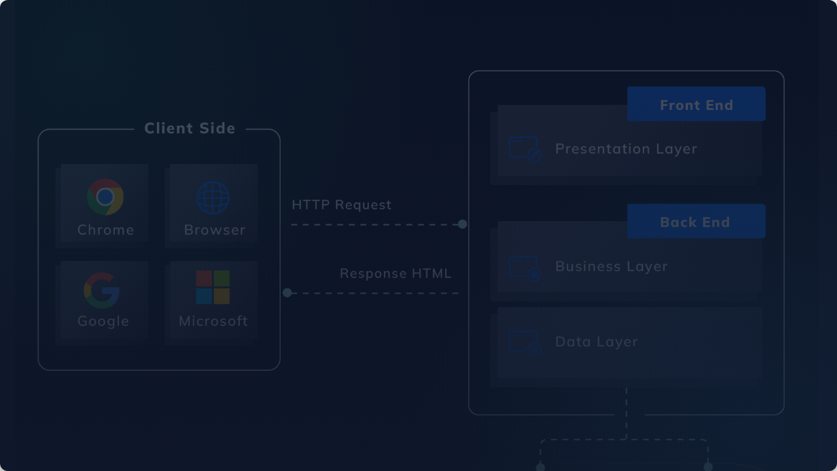
Let's Build It Live
Switching to the n8n canvas to build the Content Repurposing Agent from scratch using local LLMs.

